Slide 1
Smartphone Background Activities in the Wild:
Origin, Energy Drain, and Optimization
Xiaomeng Chen
Abhilash Jindal
Ning Ding
Y. Charlie Hu
Maruti Gupta
Rath Vannihamby
Purdue University
Mobile Enerlytics
Intel Corporation

Slide 2


Important features to buy new phones
http://www.theguardian.com, May 2014
How often do users charge phones?
http://mobileenerlytics.com/blog/?p=14, Dec 2014

Slide 3
Energy Measurement Study
Trace statistics ^{[1]}:
Devices (> 10 days trace) | 2000
Unique phone types | Galaxy S3 & Galaxy S4
Median trace duration | 28 days
Hybrid power model ^{[2]}:
Utilization-based
CPU
GPU
Screen
Finite State Machine
WiFi
3G/LTE
Constant
WiFi
beacon
WiFi
scan
Cellular
paging
SOC
suspension
[1]eStar Energy Saver: https://play.google.com/store/apps/details?id=com.mobileenerlytics.estar
[2] Smartphone Energy Drain in the Wild: Analysis and Implications (Sigmetrics 2015)

Slide 4
Energy Measurement Study
46% screen-off energy

Slide 5
Energy Measurement Study
17% maintenance energy

Slide 6
Energy Measurement Study
Reduce energy by optimizing background activities during screen-off
29% energy due to background activities during screen-off
Notes:
And the rest 29% energy is due to background activities of the installed apps.
This provide us a good opportunity to reduce energy from background activities during screen-off

Slide 7











Screen-off Activities
Pre-fetch updates
Notifications
Non-touch based user interactions

Slide 8
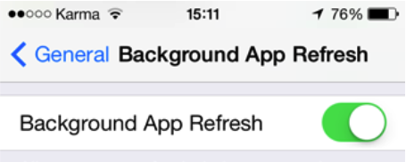
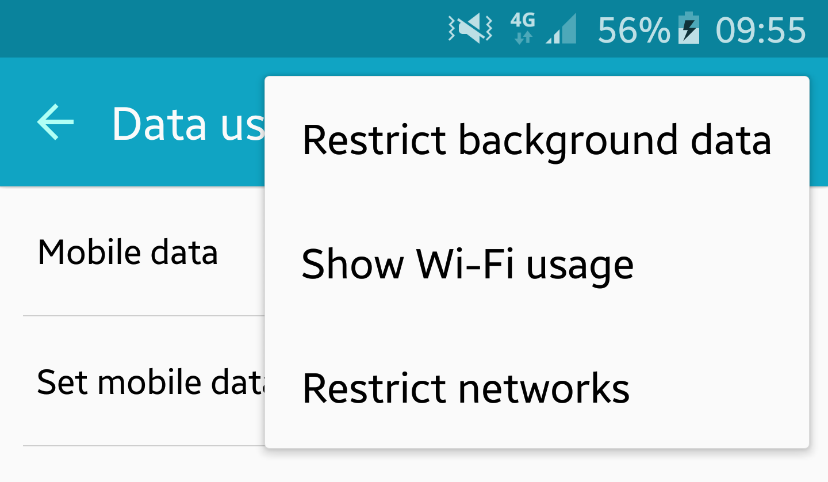
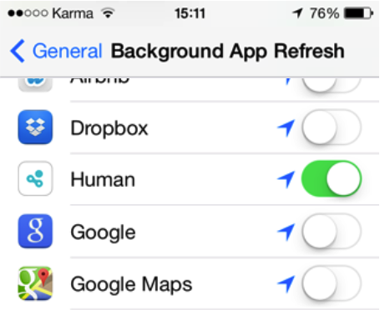
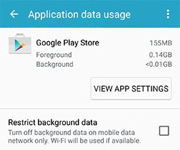

Current Solutions to Disable Screen-off Activities
iOS
Android
Disable useful background activities, affecting user experience
iOS
Android
Yelp
Too cumbersome for users

Slide 9

Our Goal
Automatically suppress background activities during screen-off that are not useful to users

Slide 10
Key Hypothesis
Usefulness of app screen-off activities is
  app-dependent
  user-dependent
Intuitive
Validated by real-world data

Slide 11
Outline
How to quantify usefulness?
  Test the hypothesis
How to develop an online algorithm to optimize screen-off energy?

Slide 12
Quantify Usefulness:
Background-Foreground Correlation (BFC)
1. Define per-interval
Screen-off interval
Screen-on interval
Background activity
Foreground activity
time
b₁
b₂
2. BFC is the average of
0 → low correlation → useless
1 → high correlation → useful

Slide 13
BFC of 2000-User Traces
BFC is app-dependent
  60% of apps have zero BFC
BFC is user-dependent

Slide 14
Prediction-based Online Algorithm
1. Keep track of per-app BFC for each user using exponential moving average
,
2. Suppress background activities in interval
if

Slide 15
Evaluation Metrics
1. Energy saving:
2. Staleness:
time
Foreground activity
Background activity

Slide 16
Evaluation of Prediction-based Online Algorithm
2.5x staleness increase
16.4% avg. energy saving (upper bound = 29%)
Can we improve staleness and maintain energy saving?

Slide 17
Analysis of High Staleness

Slide 18
Exponential Backoff Algorithm
Original algorithm：
Foreground activity
Background activity
time
staleness
Relax the strictness
of suppressing
Exponential backoff：
time
threshold time:

Slide 19
Exponential Backoff Algorithm
Original algorithm：
Foreground activity
Background activity
time
staleness
Relax the strictness
of suppressing
Exponential backoff：
time
staleness

Slide 20
Evaluation of Exponential Backoff Algorithm
staleness increase 2.5x →1.3x
avg. energy saving 16.4% → 15.7%
staleness of individual apps reduces

Slide 21
Architecture of HUSH
ActivityManagerService
BatteryStatsImpl.Uid.Pkg.Serv
updateFg
updateBg
BroadcastQueue
BatteryStatsImpl.Uid.Pkg{
long mBgTime;
long mThrTime;
void updateFg(){…}
void updateBg() {…}
boolean allowHush() {…}
}
LocationManagerService
allowHush
…
PendingIntentRecord
Intercept framework modules to suppress background activities on behalf of apps
TelephoneRegistry

Slide 22
Early Evaluation of HUSH
2 Users: 3 days with original Android, 3 days with HUSH
 | User - 1 |  | User - 2
Number of installed apps | 73 |  | 52
Daily screen-on intervals | 85 |  | 29
Daily screen-on time (min) | 82.35 |  | 49.95
Daily suppressions by HUSH | 4400 |  | 5543
 | Android | HUSH | Android | HUSH
Daily CPU busy time (min) | 164.2 | 97.40 | 60.81 | 27.24
Maintenance power (mA) | 12.76 | 12.76 | 12.12 | 12.12
Avg. screen-off power (mA) | 15.57 | 5.27 ⬇ | 3.19 | 2.18 ⬇
Avg. screen-on power (mA) | 316.8 | 323.5 ⬆ | 271.4 | 273.0 ⬆
Overall avg. power (mA) | 45.50 | 36.34 ⬇ | 27.32 | 18.99 ⬇
3x
1.5x
1.3x
1.4x

Slide 23
Conclusion
Energy measurement study in the wild
  29% of daily energy due to background activities during screen-off
Quantify usefulness of background activities
  Background-Foreground Correlation
Usefulness is app-dependent and user-dependent
Screen-off energy optimizer: HUSH
  Save 15.7% daily energy on average
  Available at https://github.com/hushnymous/

Slide 24
Backup

Slide 25
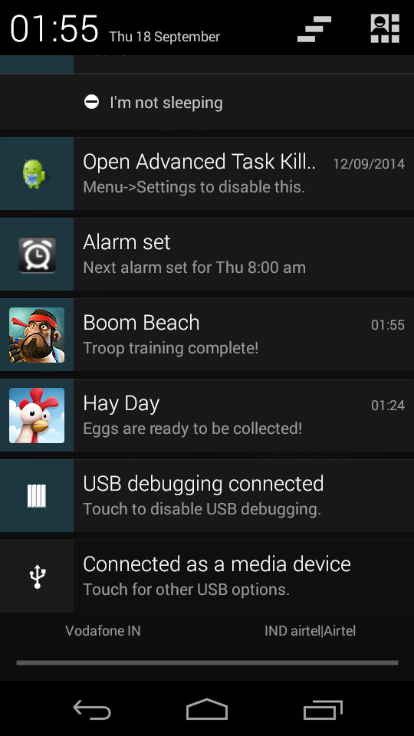

Slide 26
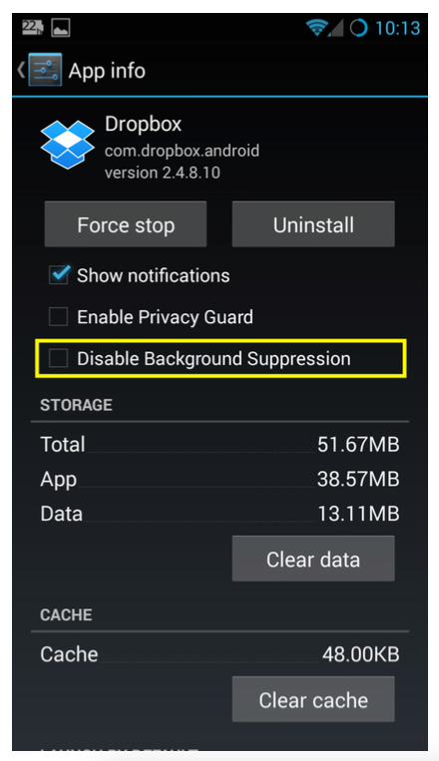
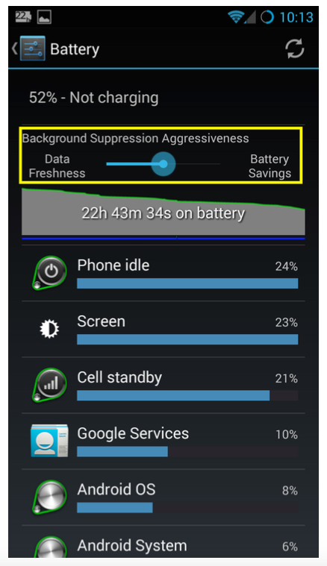
Features of HUSH
Allow to adjust background
suppression aggressiveness
Allow to disable
background suppression

